Slide 1
Team 4 Observations and Findings
Sam Hudson, Bastien Camillo, Mary Lucas

Slide 2
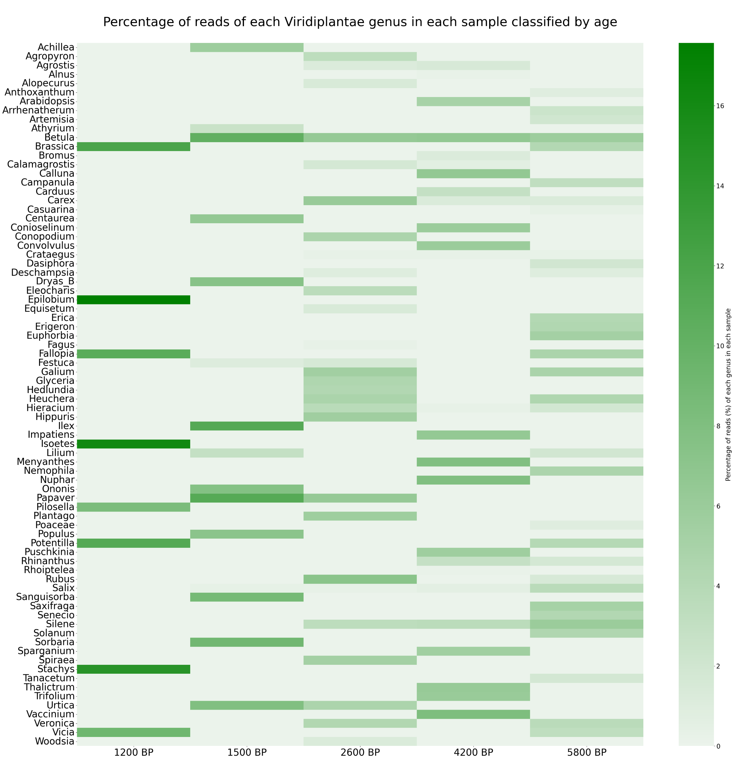

Slide 3
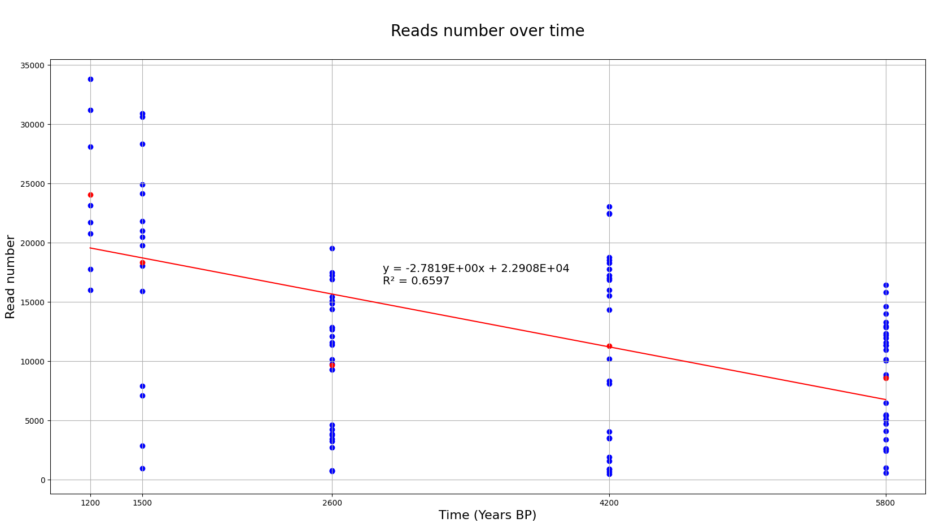

Slide 4
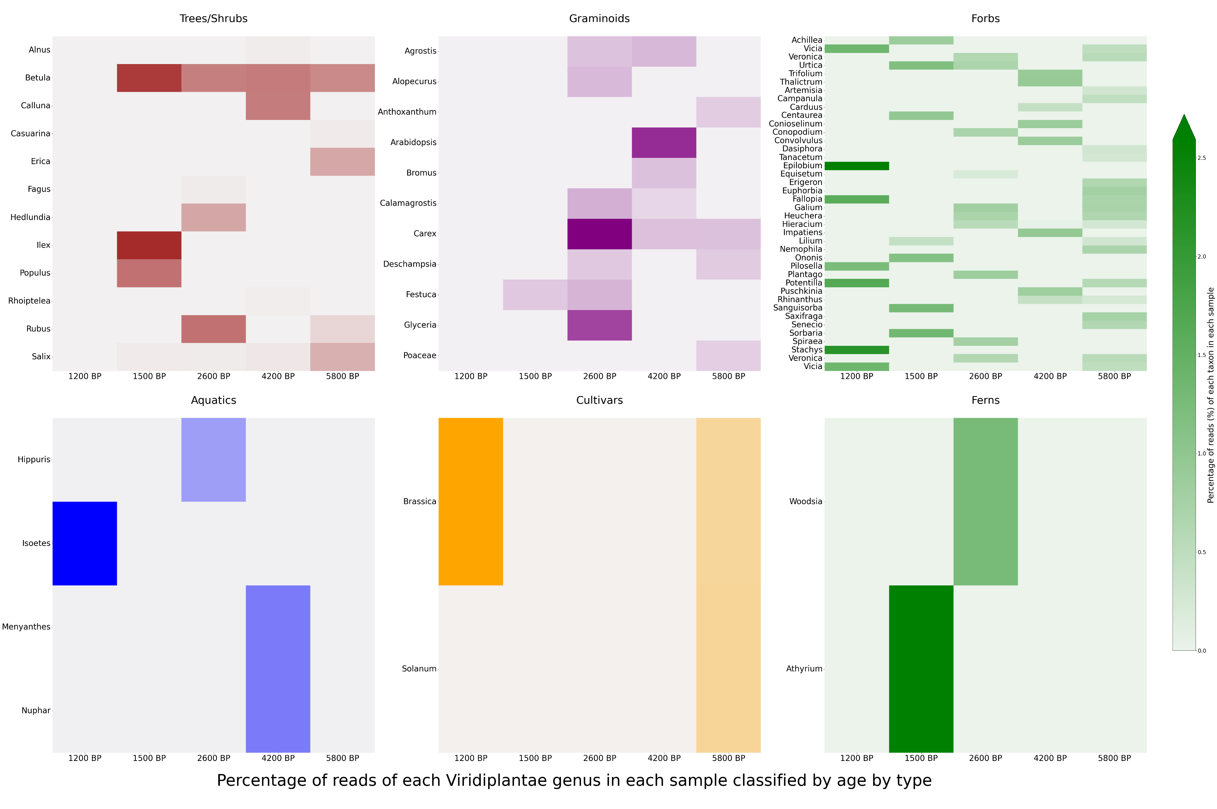

Slide 5
Observations
Testing of sediment types and aDNA binding/preservation
Identifying pathogens in sediments
Burial environments with individuals of known cause of death
Try to find pathogens from these environments using capture probe
Lake sediment- how confident can we be that DNA leaching does not occur in this context- how much of problem are worms.

